Slide 1
Regular Expressions in Django URLs
Dr. Navneet Kaur

Slide 2
Square Brackets [ ]
Square brackets are used to define a character set. Inside square brackets, you can list the characters you want to match. For example, [abc] matches either 'a', 'b', or 'c'. You can also use ranges like [a-z] to match any lowercase letter from 'a' to 'z'. To include a hyphen '-' itself in a character set, you should either escape it or place it at the beginning or end of the set.

Slide 3
Negation ^
Placing a caret (^) at the beginning of a character set negates it, meaning it matches any character not listed in the set. For example, [^0-9] matches any character that is not a digit.

Slide 4
Shorthand Character Classes
Regular expressions provide shorthand for common character sets:
\d: Matches any digit, equivalent to [0-9].
\D: Matches any non-digit character, equivalent to [^0-9].
\w: Matches any alphanumeric character plus underscore, equivalent to [a-zA-Z0-9_].
\W: Matches any non-alphanumeric character, equivalent to [^a-zA-Z0-9_].
\s: Matches any whitespace character (space, tab, newline).
\S: Matches any non-whitespace character.

Slide 5
Quantifiers
* (Zero or more): The asterisk (*) matches zero or more occurrences of the preceding element. For example, a* matches '', 'a', 'aa', 'aaa', and so on.
+ (One or more): The plus sign (+) matches one or more occurrences of the preceding element. For example, a+ matches 'a', 'aa', 'aaa', and so on, but not ''.

Slide 6
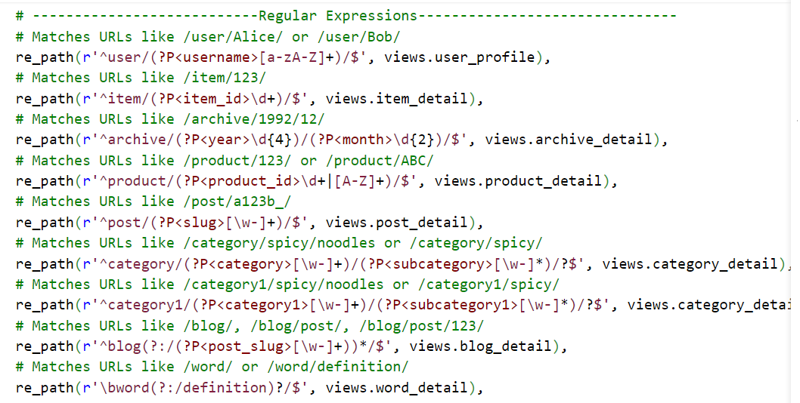

Slide 7
